Slide 1
CSE322
Minimization of finite Automaton
Lecture #6

Slide 2
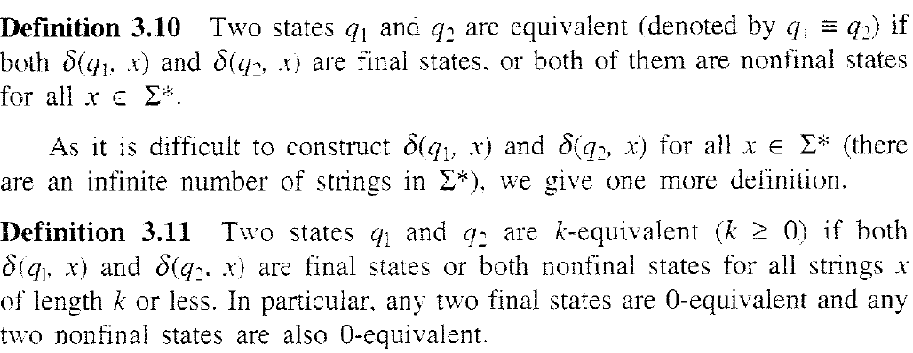
Definitions

Slide 3
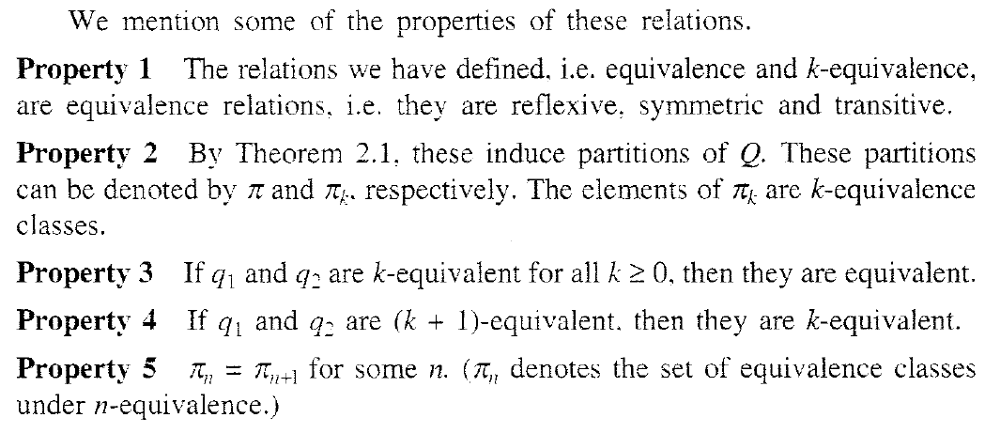
Properties

Slide 4
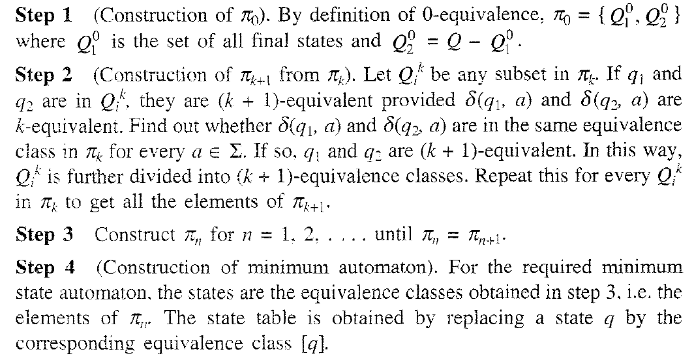
Construction of Minimum Automaton

Slide 5
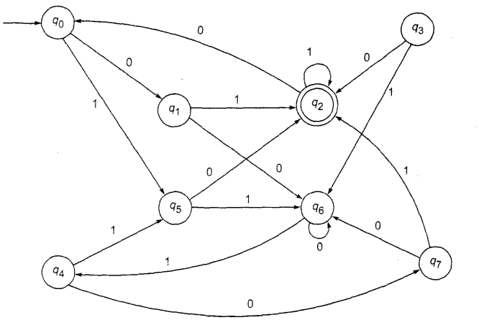
Problem
Construct a minimum state automaton equivalent to finite automaton

Slide 6
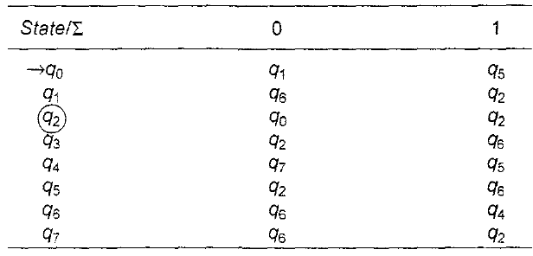

Slide 7


Slide 8


Slide 9
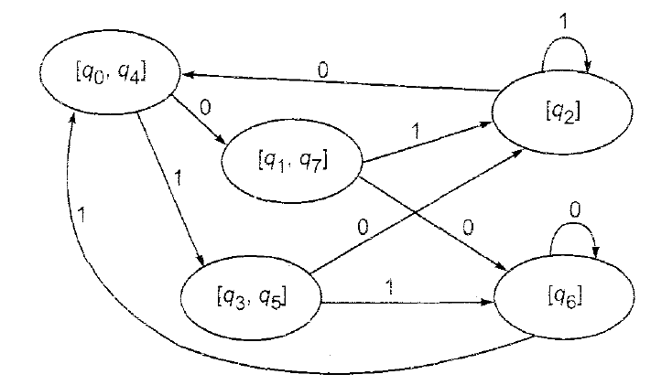
Solution

Slide 10
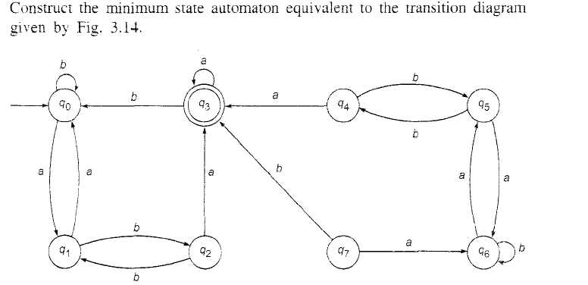

Slide 11
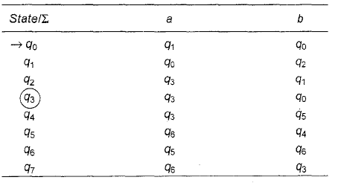

Slide 13
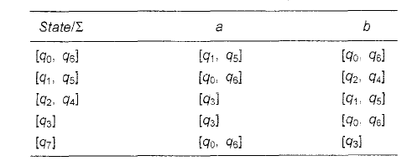

Slide 14
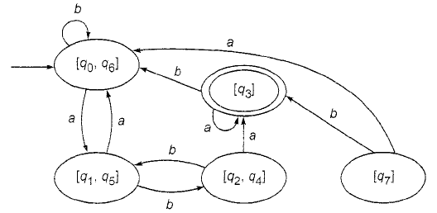

Slide 15
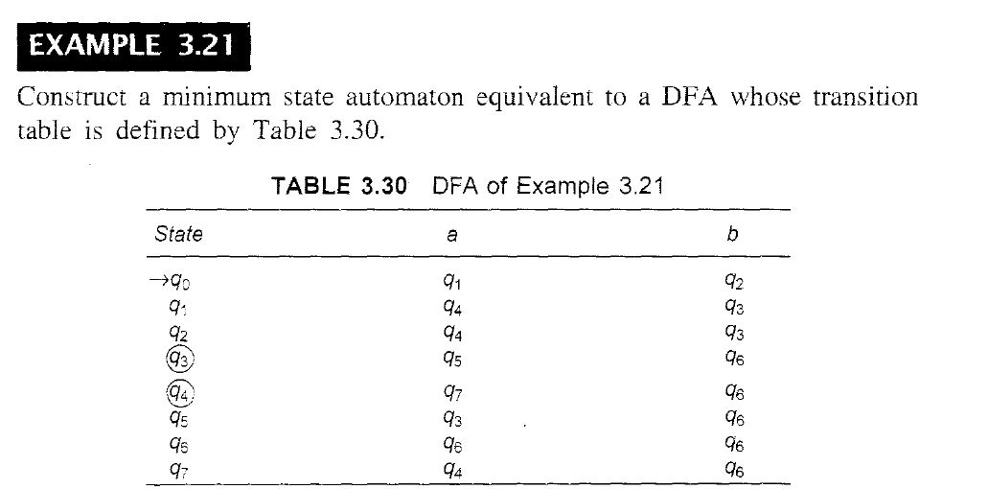
Minimize the given automata

